Slide 1
Enhancing Slurred Speech: A Deep Learning Approach
By
Harshitaa Yarramsetti, Sri Kavya Hariharan
Reg. No: 195002048, 195002116
Guided by Prof. A. Shahina

Slide 2
Problem Statement
The prevalence of dysarthria as one of the most common speech pathologies makes Automatic Speech Recognition of said slurred speech error prone. This is a consequence of the high variability in the patients’ speech which makes generalization systems the need of the hour. Thus, we propose Enhancing Slurred Speech using deep learning by adopting a one shot learning framework. We aim to study the feasibility and applications in a generalized enhancement system in accessibility concerns of the patients.

Slide 3
Literature Survey
Wang, Disong, et al. "End-to-end voice conversion via cross-modal knowledge distillation for dysarthric speech reconstruction." ICASSP 2020-2020 IEEE International Conference on Acoustics, Speech and Signal Processing (ICASSP). IEEE, 2020.
A seq2seq TTS with encoder, attention and decoder is trained on normal speech to generate character embeddings and a cross modal knowledge distillation system. Metrics used were MOS and one human recognition score and WER of 9.33 on high dysarthria.
Chen, Chen-Yu, et al. "Enhancing Intelligibility of Dysarthric Speech Using Gated Convolutional-Based Voice Conversion System." Interspeech. 2020.
The Gated CNN can capture such long-range dependencies and the gated activation functions can be trained on the data so there is greater control on what information passes through the hierarchy with the enhanced speech accuracy at a rate of 85.9%.

Slide 4
Literature Survey
Yang, Seung Hee, and Minhwa Chung. "Improving dysarthric speech intelligibility using cycle-consistent adversarial training." arXiv preprint arXiv:2001.04260 (2020).
This paper proposes a style transfer approach by using cycle consistent loss in GANs to reduce the domain space of the possible mapping functions or outputs. The dysarthric speech WER is 66.7 while the enhanced speech WER is 33.3.
Huang, Wen-Chin, et al. "Towards identity preserving normal to dysarthric voice conversion." ICASSP 2022-2022 IEEE International Conference on Acoustics, Speech and Signal Processing (ICASSP). IEEE, 2022.
This paper proposes an identity preserving Dysarthric to Normal seq2seq based VC model called Voice Transformer Network. UA Speech dataset is used for the metrics such as P-ESTOI/P-STOI, Phoneme Error Rate, Naturalness, severity and similarity.

Slide 5
Literature Survey
Zhao, Wei, et al. "IVCGAN: An Improved GAN for Voice Conversion." 2021 IEEE 5th Information Technology, Networking, Electronic and Automation Control Conference (ITNEC). Vol. 5. IEEE, 2021.
In this paper, we propose a new voice conversion network based on GAN network, which is a voice conversion technique that relies on non-parallel data and is capable of converting samples of arbitrary duration. This network is called IVCGAN
Sisman, Berrak, et al. "On the study of generative adversarial networks for cross-lingual voice conversion." 2019 IEEE Automatic Speech Recognition and Understanding Workshop (ASRU). IEEE, 2019.
In this approach, we propose to use Generative Adversarial Networks (GANs) for cross-lingual voice-conversion. We further the studies on Variational Autoencoding Wasserstein GAN (VAW-GAN) and cycle-consistent adversarial network (CycleGAN), that are known to be effective for mono-lingual voice conversion.

Slide 6
Literature Survey
Gatys, Leon A., Alexander S. Ecker, and Matthias Bethge. "Image style transfer using convolutional neural networks." Proceedings of the IEEE conference on computer vision and pattern recognition. 2016.
This paper uses image representations derived from Convolutional Neural Networks optimised for object recognition, which make high level image information explicit
Yan, Xiyu, et al. "Neural style transfer with content discrimination." 2019 IEEE International Conference on Multimedia & Expo Workshops (ICMEW). IEEE, 2019.
This paper proposes a novel content- aware neural style transfer algorithm by taking account of variations of image contents (e.g., smooth, salient regions).

Slide 7
Literature Survey
AlBadawy, Ehab A., and Siwei Lyu. "Voice Conversion Using Speech-to-Speech Neuro-Style Transfer." Interspeech. 2020.
In this, we introduce a deep learning-based approach to do voice conversion with speech style transfer across different speakers with the help of VAE and GAN with a 0.001% EER
An, Xiaochun, Frank K. Soong, and Lei Xie. "Disentangling style and speaker attributes for tts style transfer." IEEE/ACM Transactions on Audio, Speech, and Language Processing 30 (2022): 646-658.
An inverse autoregressive flow (IAF) technique is first introduced to improve the variational inference for learning an expressive style representation. A speaker encoder network is then developed for learning a discriminative speaker embedding, which is jointly trained with the rest neural TTS modules

Slide 8
Challenges
Limited amount of dysarthric speech available
Variations in phonemes is speaker dependent
Word labelling might be incorrect due to low intelligibility and accent differences.
Enhanced speech may not sound exactly like the normal speech due to other noise factors.
Influence or weight of style image is extremely high at times

Slide 9
Objectives
A novel approach to enhance dysarthric speech by employing Neural style transfer to do zero shot learning.
We attempt to preserve speaker identity in such a way that the meaning of the message is not compromised.
We adopt a deep learning model which enhances slurred speech into normal recognizable sentences and words, thereby, making it easier to understand the message to be conveyed.

Slide 10
Objectives
The main objective of the study is to make the source speaker's speech sound natural and similar to that of the target speaker by maintaining the linguistic content and the prosody of the original speech.
Additionally, it tries to capture the different minute variances in slurred speech and enhance them in a fine-grained manner and thereby achieve a lower word error rate.
Generalize over sequences of dysarthric speech for different speakers

Slide 11

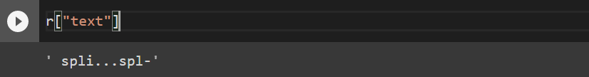
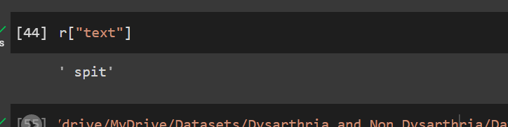
Existing SOTA ASR drawback – Whisper Inferencing

Slide 12
Proposed Methodology
For Neural style transfer (NTS), we employ the VGG19-Transfer learning CNN model that converts the given audio datasets into their respective image representations using melspectrograms.
Comparing the melspectrogram of normal and dysarthric speech, one can conclude the variations in speech .
In order to enhance this dysarthric speech NTS uses a pretrained convolutional network to transfer styles from one image to the other thereby converting the dysarthric speech melspectrogram to normal speech spectrograms.
This helps minimize the differences between the two images.
Once this is achieved, the melspectrogram is converted back to the audio file.

Slide 13
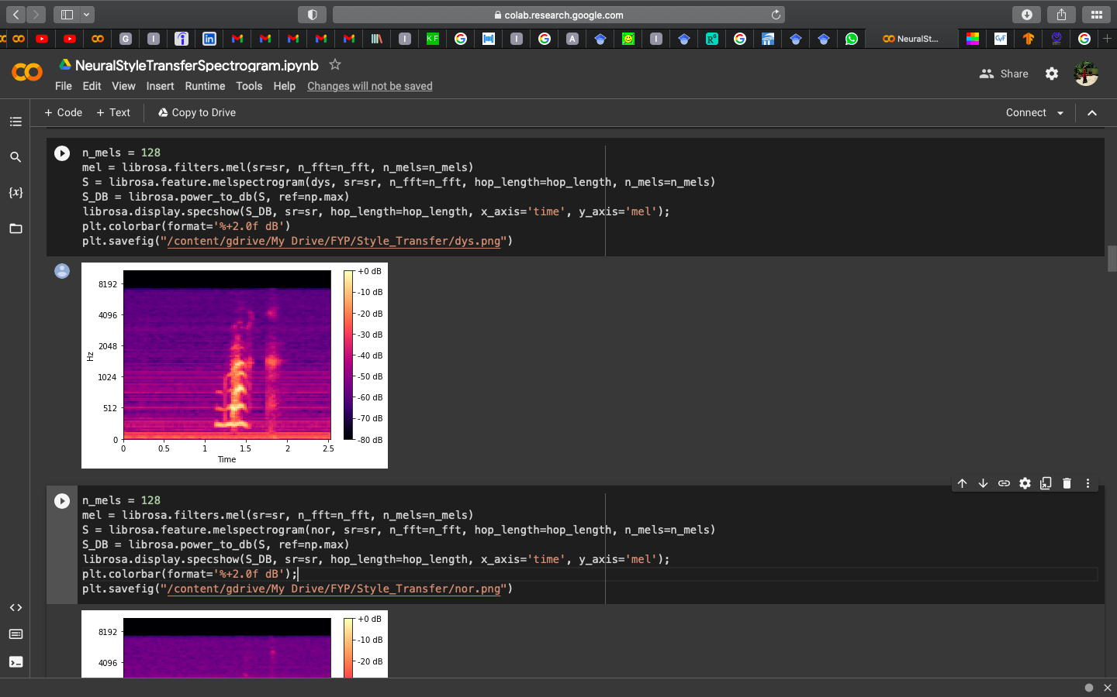
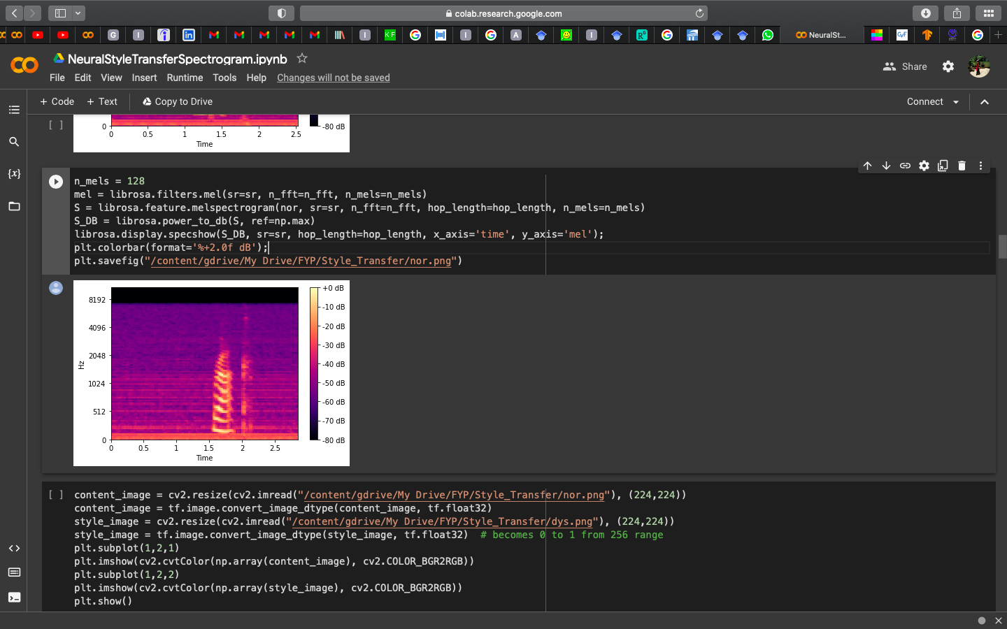
Melspectrograms – dysarthric vs control

Slide 14
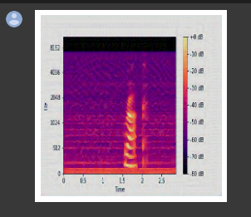
Melspectrograms – Synthesized

Slide 15
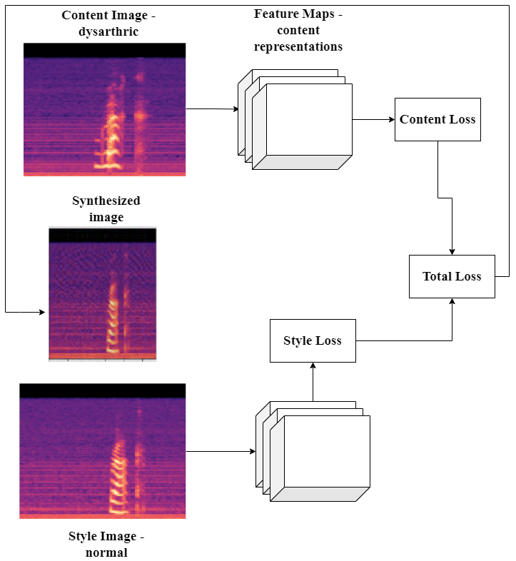
Architecture

Slide 16
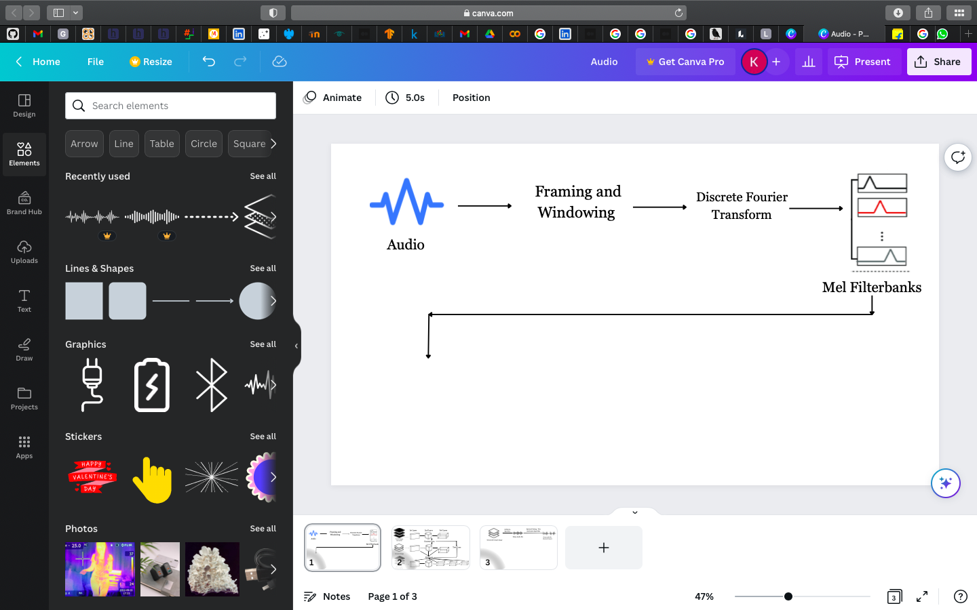
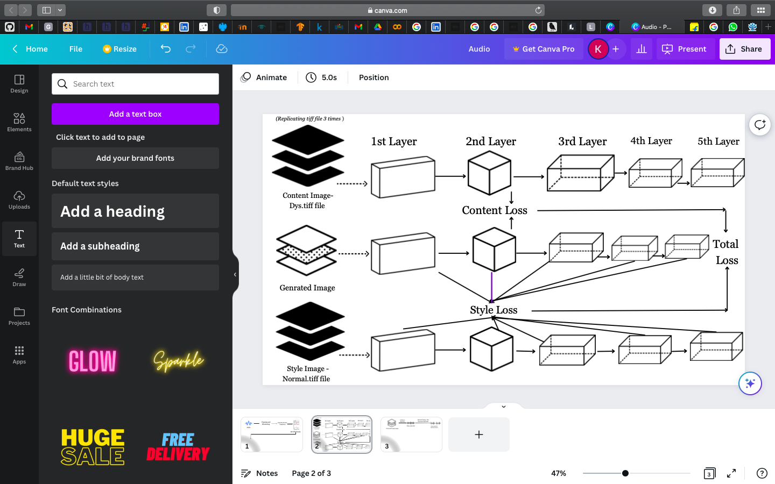
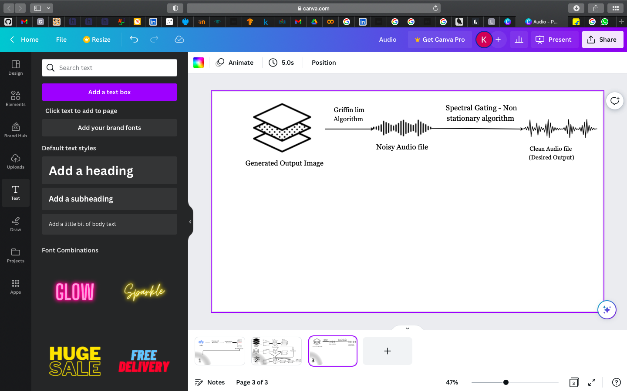
System Architecture

Slide 17
System Architecture

Slide 18
System Architecture

Slide 19
System Architecture

Slide 20
Dataset - TORGO
The TORGO database comprises of of dysarthric speech sets mainly focusing on features from people affected by cerebral palsy or amyotrophic lateral sclerosis, which are two of the most prevalent causes of speech disability.
Dysarthria is caused by disruptions in the neuro-motor interface. These disruptions distort motor commands to the vocal articulators, resulting in atypical and relatively unintelligible speech.
The TORGO database was originally a resource for developing advanced models in ASR that are mostly suited to the needs of people with dysarthria.

Slide 21
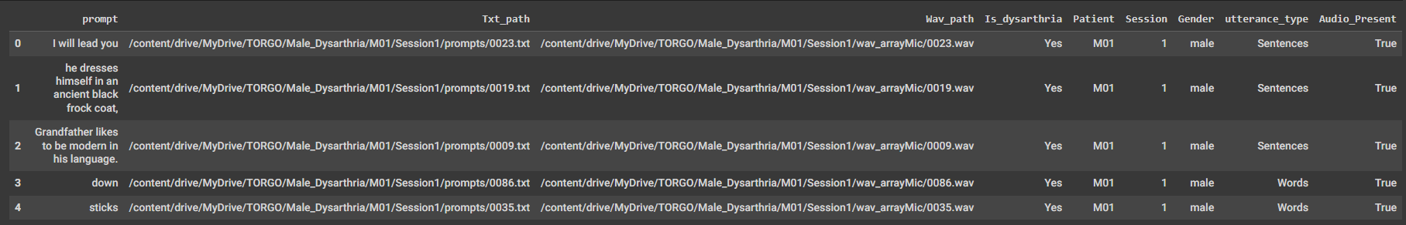
Dataset - TORGO

Slide 22
Dataset – TORGO

Slide 23
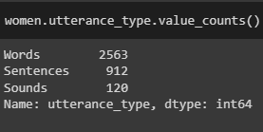
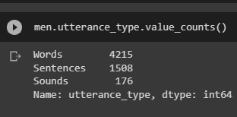
Dataset – TORGO

Slide 24
Algorithm
The initial audio waveform is converted into Mel spectrograms with a hop length of 176 and with a Fourier length of 512.
These Mel spectrograms are saved as tiff files and since these are represented as one dimensional images, they are replicated 3 times and stacked over one and other to make it a 3 channel RGB image for the VGG19 layer to function, which is then run for 60-120 epochs.
By applying Neural style transfer to these images, we get a new blended generated output image.
We then apply the Griffin Lim algorithm to the blended image to get back the audio file in wav format.
Finally, the audio input is denoised and cleansed to get the desired result.

Slide 25
Implementation
We input the audio samples of both the control and dysarthric utterance for either male/ female which are then represented as Mel spectrograms and inputted to the neural style transfer model.
The neural style transfer model we employ here utilizes transfer learning using VGG-19 Convolutional Neural Network. Transfer learning enables us to take advantage of Image Net weights without having to create a completely new model that requires millions of Mel spectrogram data graphs.
The neural style transfer module outputs the enhanced Mel spectrogram which is converted back to audio by utilizing the Griffin Lim Algorithm.

Slide 26
Implementation
4. The Griffin-Lim algorithm is an iterative algorithm used for signal reconstruction in sound processing. It involves alternating between a time-frequency analysis step, where the short-time Fourier transform is applied to the input signal, and a synthesis step, where the signal is reconstructed from the magnitude and phase of the short-time Fourier transform using an iterative phase retrieval technique.
5. Finally, the audio is denoised using the spectral gating algorithm. Spectral noise gating is a noise reduction technique used in audio signal processing that involves dividing the frequency spectrum of a signal into separate bands, and then applying a gating threshold to each band based on the level of noise in that band.

Slide 27
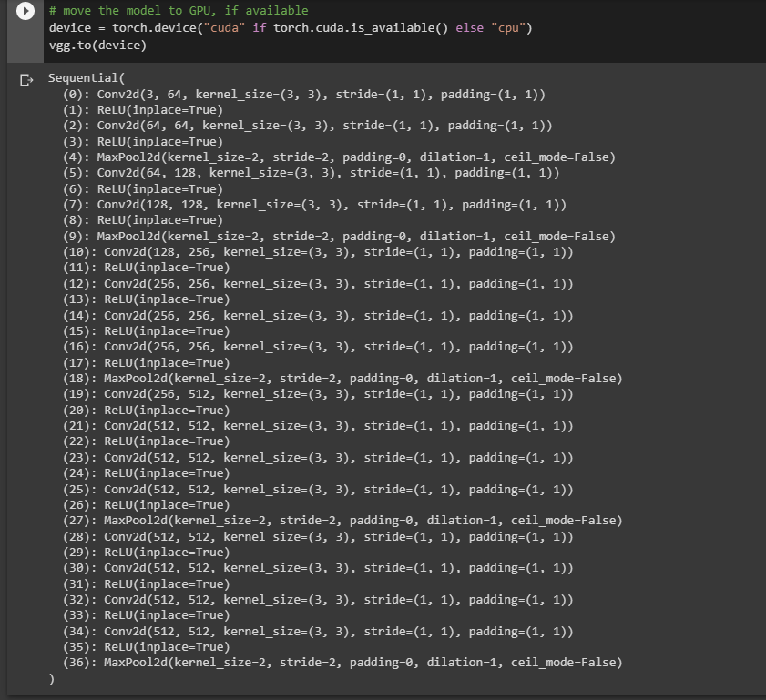
Implementation – VGG 19 Input and Structure

Slide 28
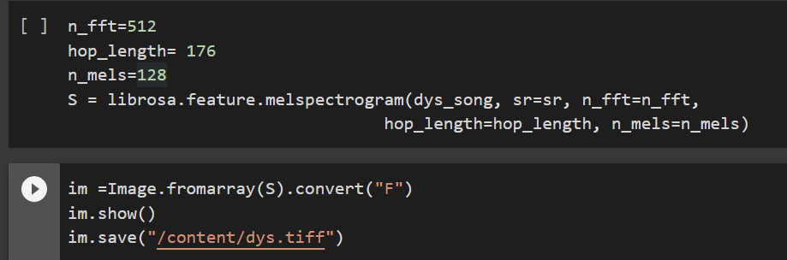
Implementation – Mel Spectrogram to Tiff

Slide 29
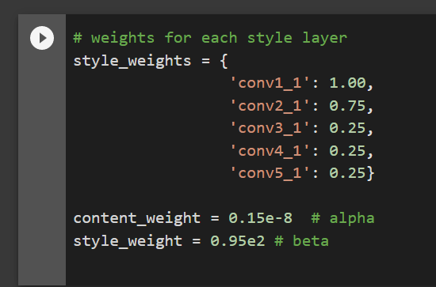
Implementation – Weights

Slide 30
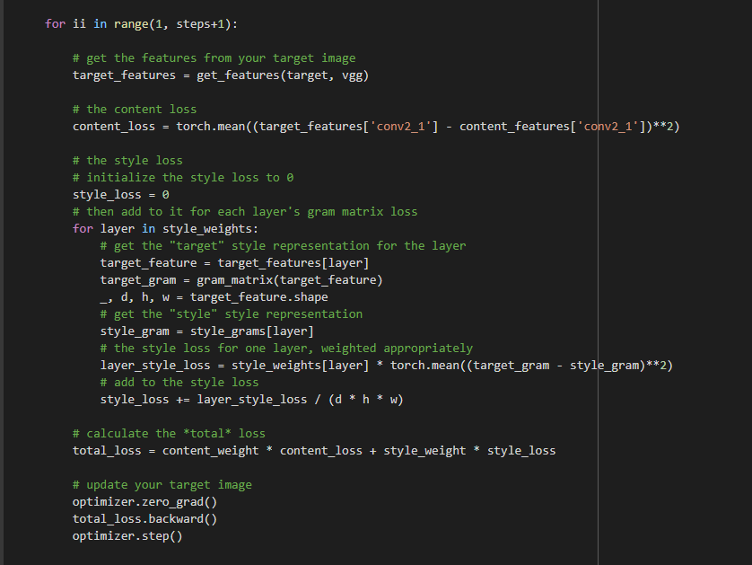
Implementation – Loss Layers

Slide 31
Comparative Study
AlexNet is a good choice for tasks that require less computational resources, but may not produce as visually appealing stylized images compared to VGG networks.
VGG19 is better suited for tasks that require more detailed features, but may require more computational resources compared to VGG16. VGG16 is a good choice for tasks that require a faster computation time, but may not be able to extract as much detail from the input images compared to VGG19.
One of the key differences between VGG19 and VGG16 is their number of parameters. VGG19 has about 144 million parameters, while VGG16 has about 138 million parameters. This difference in the number of parameters can affect the computational resources required for NST using these architectures.

Slide 32
Comparative Study
4. VGG19 is considered to be better than Alex Net in the following aspects.
Deeper network suggests learning of more complex features which is needed for a speech set like dysarthria which is already very difficult to decode.
5. Smaller filter size as compared to Alex net. Smaller filters help capture more fine-grained features in an image, leading to better performance.
6. VGG19 has a uniform architecture with 3x3 convolutional layers followed by max-pooling layers, making it easier to train and fine-tune than AlexNet's architecture, which is more complex and varied.
7. Hence, VGG19 has been deployed to enhance slurred speech caused by dysarthria.

Slide 33
Results – “AIR”
We have dysarthric and normal voice sample for a male patient along with the generated sample.
Our observation is that while the dysarthric speaker stretches the A and stresses on the R, the normal speaker does not do either. Further, the loudness is uneven in the dysarthric sample.
The generated sample has even loudness, lesser stress on A like the normal and also does not stress as much on the R. Thus the speaker characteristics are retained and style of normal speaker is present simultaneously in the generated audio

Slide 34
Results – “DARK”
We have dysarthric and normal voice sample for a male patient along with the generated sample. It does not do as well for this word

Slide 35
Evaluation Metrics - Mean Opinion Scores
Convolutional Network / Word Utterance | MOS | Quality
AIR (Male)
Alex Net | 3 | Fair
VGG16 | 4 | Good
VGG19 | 5 | Excellent
DARK (Male)
Alex Net | 1 | Bad
VGG16 | 2 | Poor
VGG19 | 4 | Good
FOXTROT (Female)
Alex Net | 2 | Poor
VGG16 | 3 | Fair
VGG19 | 5 | Excellent
GADGET(Female)
Alex Net | 1 | Bad
VGG16 | 3 | Fair
VGG19 | 4 | Good

Slide 36
Evaluation of Metrics – Itakura Saito Distances
To evaluate the effectiveness of these models, we used the Itakura distance to compare the generated speech signal with the original input speech signal.
2. We tested three different models, namely VGG19, AlexNet, and VGG16, on four different word pronunciations.
3. The first word we examined was 'AIR', spoken by a male. The Itakura distance for this word spoken by a dysarthric person was found to be the least in the VGG19 model, with a value of 931. The highest distance was observed in the AlexNet model, with a value of 1178. The VGG16 model showed a value that was centric to both, at 1129.

Slide 37
Evaluation of Metrics – Itakura Saito Distances
3. These results indicate that the VGG19 model is better suited for enhancing dysarthric speech than the other two models. The lower Itakura distance observed in the VGG19 model suggests that it is better able to capture the features of the original speech signal and generate a more intelligible speech signal.
4. The higher Itakura distance observed in the AlexNet model suggests that it may not be as effective at capturing these features, resulting in a less intelligible generated speech signal.

Slide 38
Evaluation of Metrics – Itakura Saito Distances
The Itakura Saito distance for various word utterances tested against various convolutional networks architectures are shown below:
Enhanced
931
Dysarthric
1338
Normal
Air Male
AlexNet

Slide 39
Evaluation of Metrics – Itakura Saito Distances
The Itakura Saito distance for various word utterances tested against various convolutional networks architectures are shown below:
Enhanced
1129
Dysarthric
1207
Normal
VGG16
Air Male

Slide 40
Evaluation of Metrics – Itakura Saito Distances
The Itakura Saito distance for various word utterances tested against various convolutional networks architectures are shown below:
Enhanced
1178
Dysarthric
1215
Normal
Air Male
VGG19

Slide 41
Evaluation of Metrics – Itakura Saito Distances
The Itakura Saito distance for various word utterances tested against various convolutional networks architectures are shown below:
Enhanced
894
Dysarthric
1157
Normal
Foxtrot Female
VGG19

Slide 42
Evaluation of Metrics – Itakura Saito Distances
The Itakura Saito distance for various word utterances tested against various convolutional networks architectures are shown below:
Enhanced
757
Dysarthric
1063
Normal
Foxtrot Female
VGG16

Slide 43
Evaluation of Metrics – Itakura Saito Distances
The Itakura Saito distance for various word utterances tested against various convolutional networks architectures are shown below:
Enhanced
769
Dysarthric
1184
Normal
Foxtrot Female
AlexNet

Slide 44
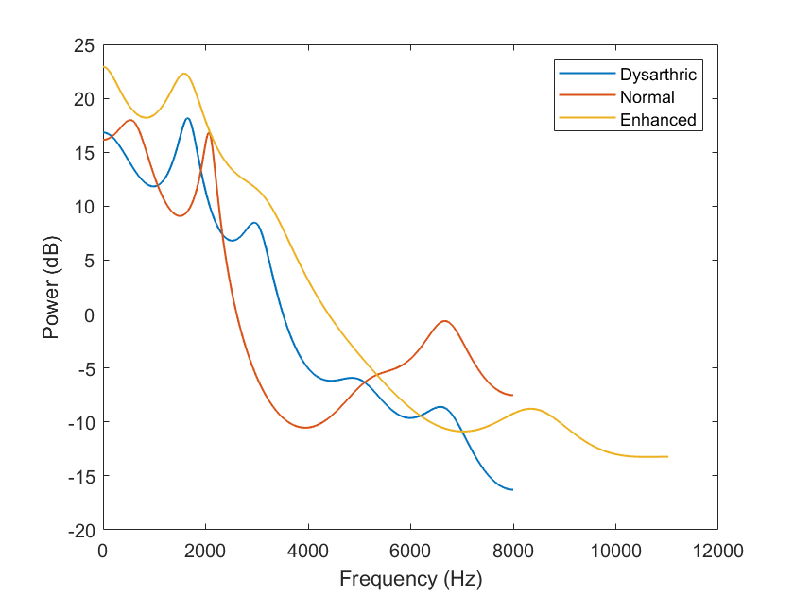
Evaluation Metrics – LP Spectra
Linear Predictive Plots for various utterances are shown below:
Air Male:

Slide 45
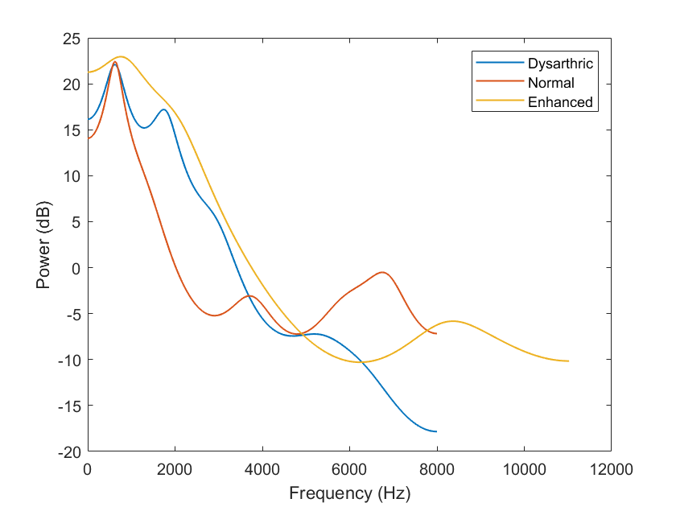
Evaluation Metrics – LP Spectra
Linear Predictive Plots for various utterances are shown below: Dark Male:

Slide 46
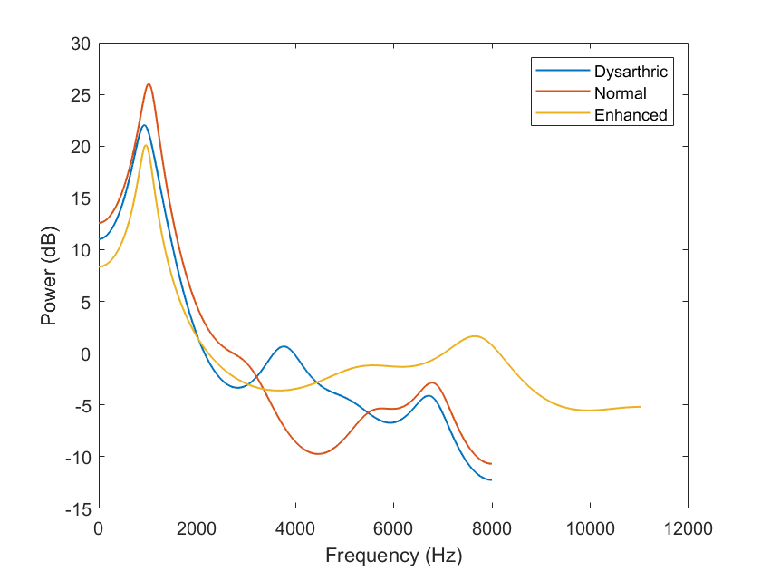
Evaluation Metrics – LP Spectra
Linear Predictive Plots for various utterances are shown below:
Foxtrot Female:

Slide 47
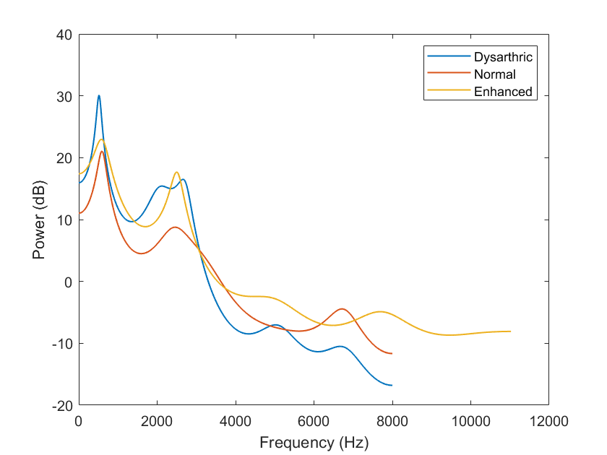
Evaluation Metrics – LP Spectra
Linear Predictive Plots for various utterances are shown below:
Gadget Female:

Slide 48
Summary
A CNN-based NST can be used as a one-shot learner for dysarthric-normal voice conversion. The model can be trained using one paired dysarthric and normal speech data to generate the enhanced utterance. The enhanced audio thus generated retains speaker characteristics of dysarthric speaker while also preserving the content of the original dysarthric speech.
The architecture of the CNN model could be based on VGG19 or a similar architecture that has been shown to be effective for NST.
The input to the model would be the mel spectrogram of the dysarthric speech, and the target output would be the mel spectrogram of the corresponding normal speech.
The model would be trained using a loss function that encourages the output mel spectrogram to match the target mel spectrogram.
The mel spectrogram can then be converted back to waveform using the Griffin Lim Algorithm, and the resulting speech can be evaluated using objective measures such as the Itakura-Saito distance and subjective measures such as MOS tests.

Slide 49
Conclusion
Thus, this experimental set up could make VC more accessible and practical for use in clinical settings, where resources are often limited.
Secondly, the model could be trained to generalize to a wider range of speech styles and speakers. By using CNN-based NST, it is possible to transfer the style of any normal speech onto dysarthric speech, without the need for a specific source or target
Thirdly, CNN-based NST could allow for greater flexibility in the conversion process.
This can limit their ability to handle situations where a specific source or target speaker is not available.

Slide 50
References
Wang, Disong, et al. "End-to-end voice conversion via cross-modal knowledge distillation for dysarthric speech reconstruction." ICASSP 2020-2020 IEEE International Conference on Acoustics, Speech and Signal Processing (ICASSP). IEEE, 2020.
Huang, Wen-Chin, et al. "Towards identity preserving normal to dysarthric voice conversion." ICASSP 2022-2022 IEEE International Conference on Acoustics, Speech and Signal Processing (ICASSP). IEEE, 2022.
Yang, Seung Hee, and Minhwa Chung. "Improving dysarthric speech intelligibility using cycle-consistent adversarial training." arXiv preprint arXiv:2001.04260 (2020).
Huang, Wen-Chin, et al. "Towards identity preserving normal to dysarthric voice conversion." ICASSP 2022-2022 IEEE International Conference on Acoustics, Speech and Signal Processing (ICASSP). IEEE, 2022.
Zhao, Wei, et al. "IVCGAN: An Improved GAN for Voice Conversion." 2021 IEEE 5th Information Technology, Networking, Electronic and Automation Control Conference (ITNEC). Vol. 5. IEEE, 2021.
Sisman, Berrak, et al. "On the study of generative adversarial networks for cross-lingual voice conversion." 2019 IEEE Automatic Speech Recognition and Understanding Workshop (ASRU). IEEE, 2019.
Gatys, Leon A., Alexander S. Ecker, and Matthias Bethge. "Image style transfer using convolutional neural networks." Proceedings of the IEEE conference on computer vision and pattern recognition. 2016.
Yan, Xiyu, et al. "Neural style transfer with content discrimination." 2019 IEEE International Conference on Multimedia & Expo Workshops (ICMEW). IEEE, 2019.

Slide 51
References
AlBadawy, Ehab A., and Siwei Lyu. "Voice Conversion Using Speech-to-Speech Neuro-Style Transfer." Interspeech. 2020.
An, Xiaochun, Frank K. Soong, and Lei Xie. "Disentangling style and speaker attributes for tts style transfer." IEEE/ACM Transactions on Audio, Speech, and Language Processing 30 (2022): 646-658.

